Slide 1


Student Details
Name: Tanmayee Inaganti
SkillsBuild Email ID: tanmayee_inaganti@srmap.edu.in
College Name: SRM UNIVERSITY AP
College State: Andhra Pradesh
Internship Domain and Internship Start and End Date: Data Analytics / June 3rd, 2024 - July 25, 2024

Slide 2
Car Dekho data analysis
The Car Dekho Data Analysis project looks at vehicle sales data to find out what affects prices and sales trends. The project aims to identify patterns and great deals by analyzing details like the year of manufacture, selling price, kilometers driven, and transmission. The goal is to provide insights that help improve sales strategies and understand the market better.

Slide 3
AGENDA
Problem Statement
Project Overview
End Users of the project
Solution and its Value Proposition
Customization
Modelling
Results
Links

Slide 4
PROJECT OVERVIEW
The Car Dekho Data Analysis project is an analysis of vehicle sales data to find important trends and patterns. The project uses Python to examine the manufacturing years, selling prices, and variety of vehicles in the data. We can check for any missing information and identify the most sold vehicles. We can also analyze how factors like age and mileage affect prices. The analysis of this data will help to provide insights that can help improve sales strategies.

Slide 5
WHO ARE THE END USERS of this project?
The following is a list of companies which sell cars, including second hand cars:
Car Dekho
CarWale
Droom
Spinny
Cars24

Slide 6
YOUR SOLUTION AND ITS VALUE PROPOSITION
#From which manufacturing year to which manufacturing year vehicles are present in this data ?
min year: 2003, max year: 2018
#What is the lowest price to which a vehicle is sold ?
Lowest price which vehicle is sold: 0.1 lakhs
#What is the highest price to which a vehicle is sold ?
Highest price which vehicle is sold: 35.0 lakhs
#How many records are there in this data ?
301 records
#Are there any missing records in this data ?
0 missing records
#How many different vehicles are present in this data ?
98 different vehicles
#Which is the most sold vehicle in this data ?
city is the most sold vehicle

Slide 7
YOUR SOLUTION AND ITS VALUE PROPOSITION
#Does the database include any CNG vehicle ? If yes how many of them are there ?
2 cng vehicles
#How many vehicles here are for sale from Individuals directly ?
106 vehicles for sale from Individuals
#Does this database contain auto transmission vehicles ? If yes how many of them are there ?
40 auto transmission vehicles
#How many single person owned vehicles are there in this database ?
290 single person owned vehicles
#Which is the most and least cost depreciated vehicle in data ?
land cruiser is the most cost depreciated vehicle, Honda Activa 4G is the least cost depreciated vehicle
#Which brands of vehicles are less affected by cost depreciation ?
['Honda Activa 4G'] are less affected by cost depreciation

Slide 8
YOUR SOLUTION AND ITS VALUE PROPOSITION
#Are there any factors which you feel affect the cost depreciation ?
The factors can be Year, Kms Driven, Depreciation to affect the cost depreciation
#In general selling price is affected by age of vehicle and distance driven by vehicle , is it observable from data ?
The answer to this question can be observed from a visualization to observe the data more accurately
#Can we get idea about newest vehicles i.e. after 2014 manufactured ?
The data shows many vehicles data after 2014 manufactured
#Can we find out data of only two wheelers from this data ? Which is the oldest bike sold here?
Yes, data of only two wheelers can be found, the oldest bike is Hero Super Splendor
#Which is the newest bike sold here?
The data shows many new bike sold
#Which is the most sold bike here?
The data shows many most sold bikes

Slide 9
YOUR SOLUTION AND ITS VALUE PROPOSITION
#Do you find any deal in two wheelers which exceeded the general expectation ? Can you find reason for it ?
The answer to this question can be observed from a visualization to observe the data more accurately
#Can we find out data of only cars from this data ?
Yes, the data of only cars can be found from this data
#Which is the oldest car sold here?
The oldest car sold is wagon r
#Which is the newest car sold here?
The newest car sold is land cruiser
#Do you find any deal in cars which exceeded the general expectation ? Can you find reason for it ?
The answer to this question can be observed from a visualization to observe the data more accurately

Slide 10
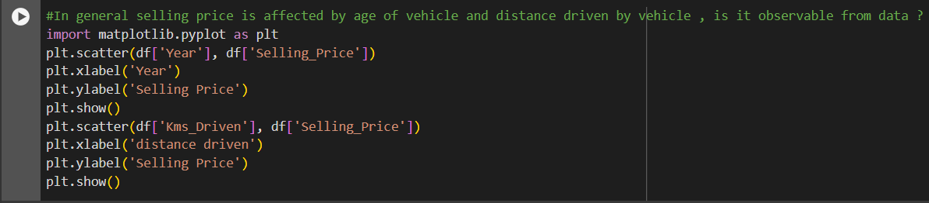
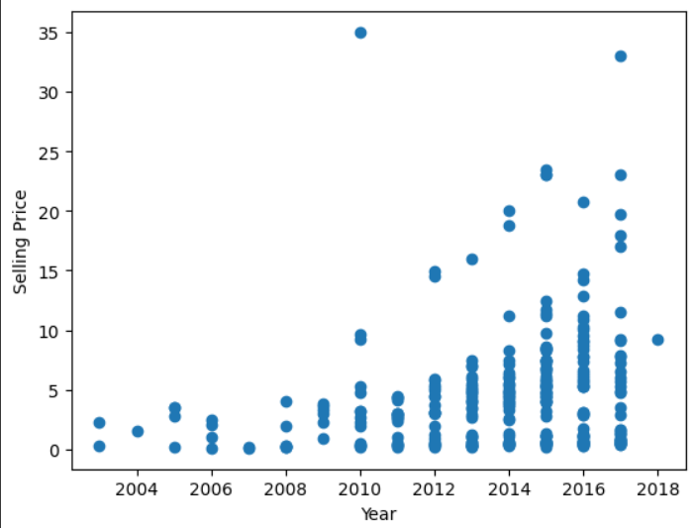
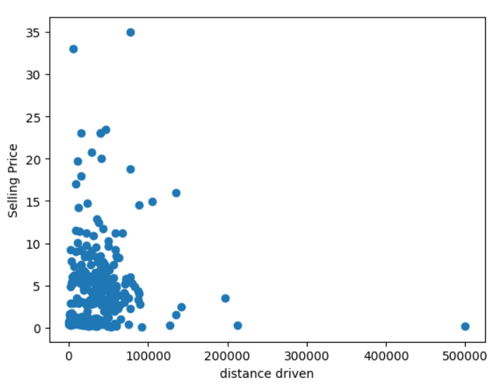
How did you customize the project and make it your own
I made two scatter plots to show:
How selling price is affected by age
How selling price is affected by distance driven by vehicle

Slide 11
MODELLING
Loaded the dataset (CarDekho) in Google Collab
Cleaned the data and checked for missing values, null values
Imported libraries: Pandas, NumPy, Matplotlib to analyze the data
Analyzed the results to answer various questions to identify certain trends in the data
Created visualizations (box plots, scatter plots) to better understand the results from the data

Slide 12
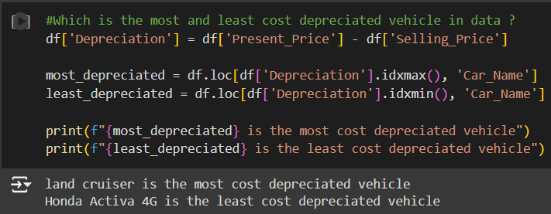
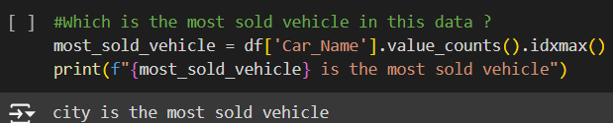
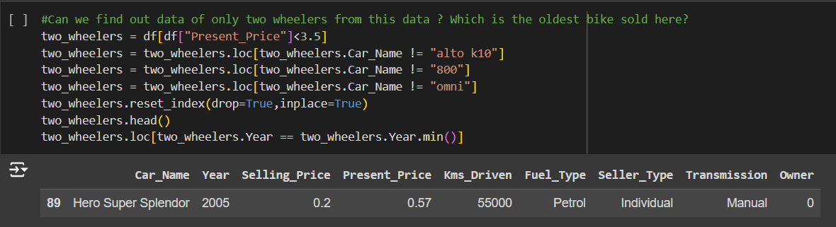
Results

Slide 13
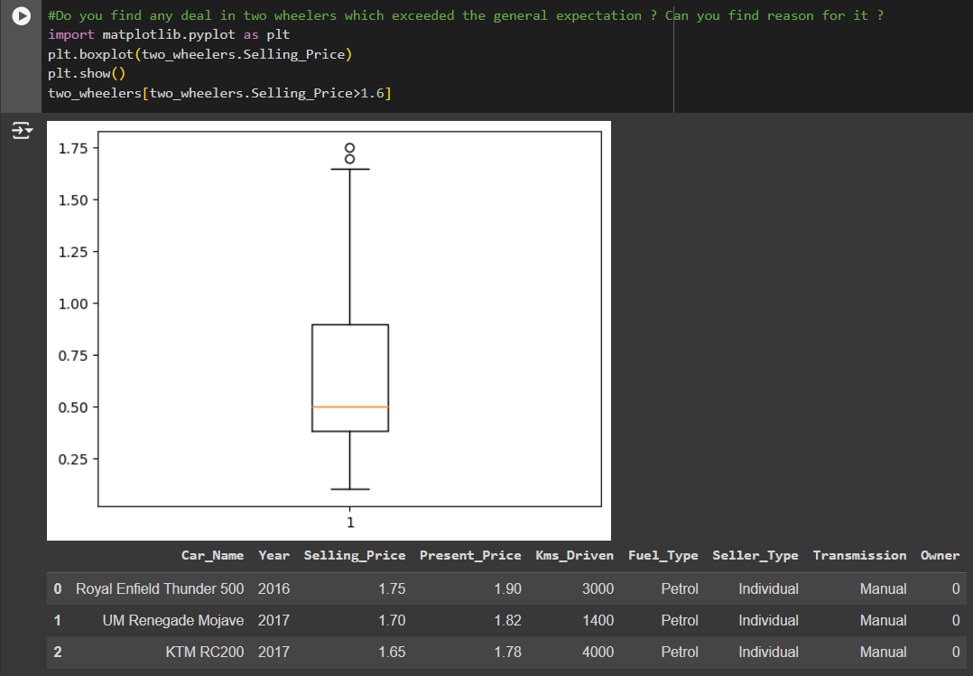
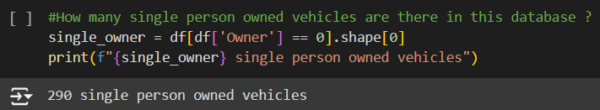
Results

Slide 14
links
https://drive.google.com/drive/folders/1OaC9eLP_Rl2YrotEnVN1RBxFK6XTF5UX?usp=sharing

